Slide 1

Adaptive IDS with Machine Learning
CYBER 05

Slide 2
Content Overview
Brief Intro to IDS/IPS
Abstract-summary
Project details
Implementation using ML
Progress
Novelty of idea
Conclusion

Slide 3
So, What are the Main Types of IDS ?
Signature-based intrusion detection — These systems compare the incoming traffic with a pre-existing database of known attack patterns known as signatures. Detecting new attacks is difficult. The vendors supplying the systems actively release new names. (similar to anti-virus software)
Anomaly-based intrusion detection — It uses statistics to form a baseline usage of the networks at different time intervals. They were introduced to detect unknown attacks. This system uses machine learning to create a model simulating regular activity and then compares new behaviour with the existing model.

Slide 4
Main Types of IDS Based on Where They Discover Anomaly
Network intrusion detection (NIDS) — It is a strategically placed (single or multiple locations) system to monitor all the network traffic.
Host intrusion detection (HIDS) — It runs on all devices in the network which is connected to the internet/intranet of the organization. They can detect malicious traffic which originates from within (for example, when malware is trying to spread to other systems from a host in the organization)

Slide 5
Classification of IDS Based on Their Action
Active — it is also known as an intrusion detection and prevention system. It generates alerts and logs entries along with commands to change the configuration to protect the network
Passive — it just detects malicious activity and generates an alert or logs, but it doesn’t take any action.

Slide 6
Limitations of the Above Types of IDS that We are Trying to Overcome in Our Project :
Real Attacks are far less than the number of false alarms raised causing real threats to go unnoticed.
Constant Upgrades are Needed for Signature-Based IDS to keep up with the new threats.
Protocol-Based Attacks can cause the IDS To fail as they monitor the entire network.
Network IDS can create bottleneck as all inbound & outbound traffic passes through it.
Host IDS rely on audit logs hence a threat to its integrity.

Slide 7
Then, Which type of IDS are WE working on ?
We are working on the Adaptive Intrusion Detection Technology.
Here, most the previously mentioned limitations can be prevented.
It can adapt according to the threat analysis training it receives and predicts the threats in real-time in a more efficient manner.

Slide 8
How can Machine Learning Help in the Concept of IDS ?
ML gives computers the capability to learn & improve from experience without being programmed explicitly automatically.
It focuses on the development of programs using data to discover themselves.
It looks for patterns in Data and makes predictions based on examples provided in it’s training set.

Slide 9
Classification of ML Algorithms
SUPERVISED ML ALGO: can apply what has been learnt in the past to predict future events using labelled example. After training, it can provide targets for new inputs.
UNSUPERVISED ML ALGO: are used when the information used to train is neither marked nor classified. Here, the machine groups the unsorted information according to patterns, similarities and differences without any prior training data.

Slide 10
Contd.
SEMI-SUPERVISED ML ALGO: makes use of unlabelled data for training with less labelled data and numerous unlabeled data.
NOTE: Semi-Supervised Learning falls between Unsupervised and Supervised Learning. Used when there’s not enough labelled data to produce an accurate model.

Slide 11
ABSTRACT & BRIEF SUMMARY OF PREVIOUS DISCUSSION
As we had discussed previously our primary goal in doing this project is to create an adaptive IDS which has the potential to learn the behaviour of the new kinds of threats with Deep learning and attack tactics emerging everyday, identify them in real time, block them with high precision and also update the behaviour in a rule-based database, so that future attacks could be prevented to an initial level.
This is the uniqueness that such a system could bring to a tech sectors dominated by traditional classification, regression analysis or even less effective and way more common signature based detection.

Slide 12
Our progress
So Far ...

Slide 13
OUR WORK …
Configuring Snort
As per our last demonstration of the working of the Snort tool we finished up the custom rule set and made some configuration changes
Research
Next we did extensive analysis and found some existing research papers detailing the efficacy of Deep learning models in Anomaly detection.
The model
Next we did a research on the efficiency of various models and what would be the best fit for our project and the next task was to find the proper dataset

Slide 14
Our Dataset Selection
Name: CSE-CIC-IDS-2018
Description: It is a collaborative project between the Communications Security Establishment (CSE) & the Canadian Institute for Cybersecurity (CIC)
What’s Unique in the Dataset? The dataset has been recorded on a daily basis using the raw network traffic (Pcaps) and Event Logs (Windows & Ubuntu).
Feature Importance Pre-defined: CICFlowMeter-V3

Slide 15
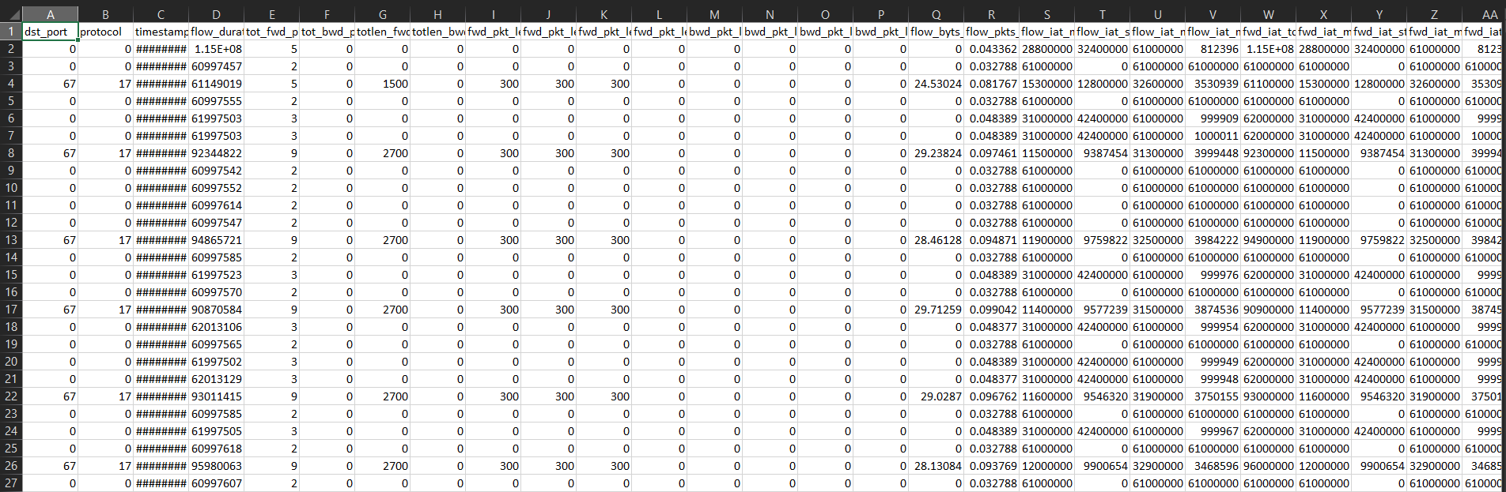
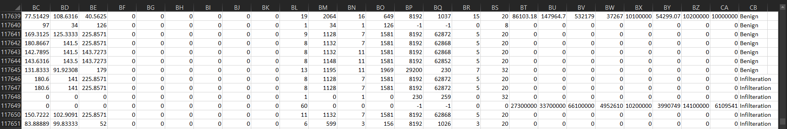

Slide 16

Feature Selection & Model Training

Slide 17
1.
Import Required Libraries and the Infiltration Dataset

Slide 18
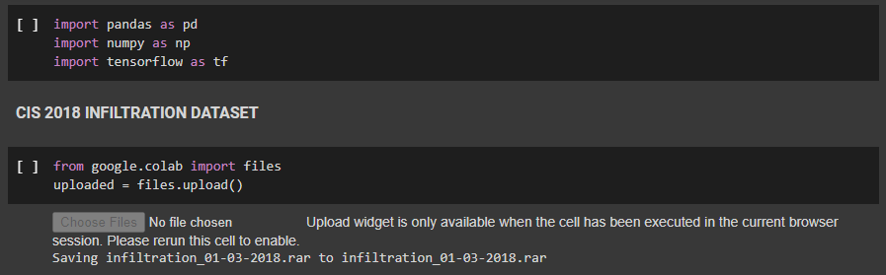
Several Other Libraries were imported in due course of model training.
The above image shows only the primary imports and the Dataset Loading

Slide 19
2.
Pre-Process Data
Preprocessing the data for ML involves both data engineering and feature engineering. Data engineering is the process of converting raw data into prepared data. Feature engineering then tunes the prepared data to create the features expected by the ML model.

Slide 20
3.
Identify And Handle Missing Data
Delete Columns/ Rows that are not required.
2. Replace infinite, NAN Data Values

Slide 21
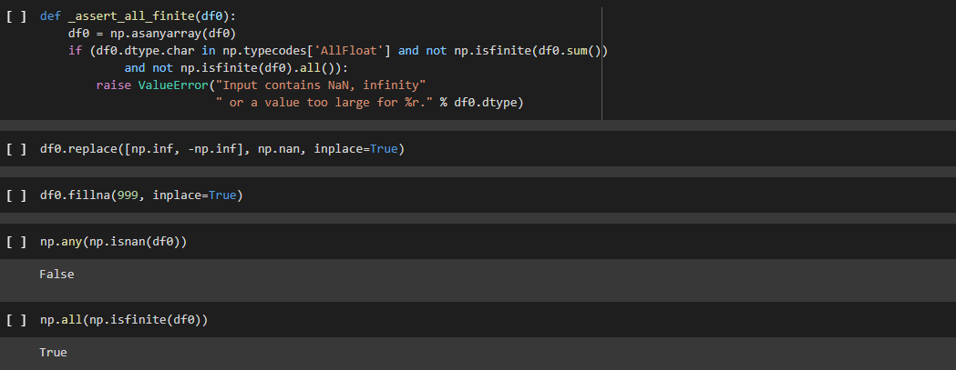

Slide 22
4.
Variable Encoding
Encoding is the process of converting data from one form to another.Encoding refers to a specific type of encoded data. There are several types of encoding, including image encoding, audio and video encoding, and character encoding.

Slide 23

5.
Data Splitting
Split data into labels and data for model training
X_train – features for the training data
X_test – features for the test data
y_train – dependent variables for training data
y_test – independent variable for testing data

Slide 24

FINAL MODEL TRAINING
6.

Slide 25
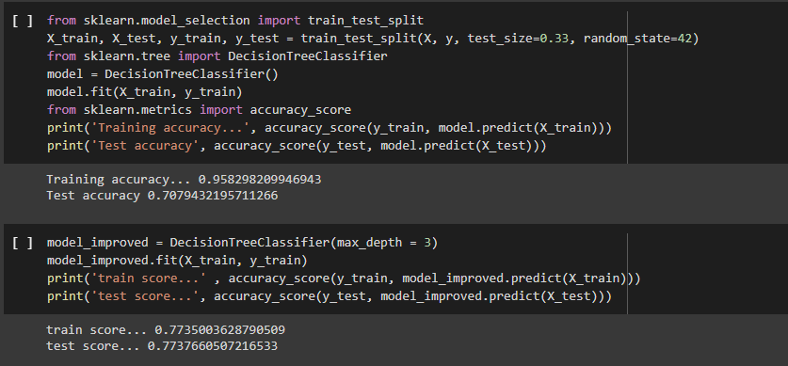
Decision Tree Classifier

Slide 26
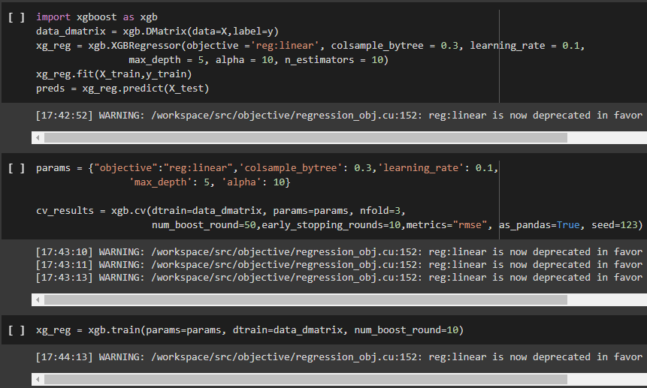
B) Using XGBOOST To Train Model and Check predictions

Slide 27
C) Using Feature Importance & Selection
Feature scaling marks the end of the data preprocessing in Machine Learning. It is a method to standardize the independent variables of a dataset within a specific range. In other words, feature scaling limits the range of variables so that you can compare them on common grounds.

Slide 28
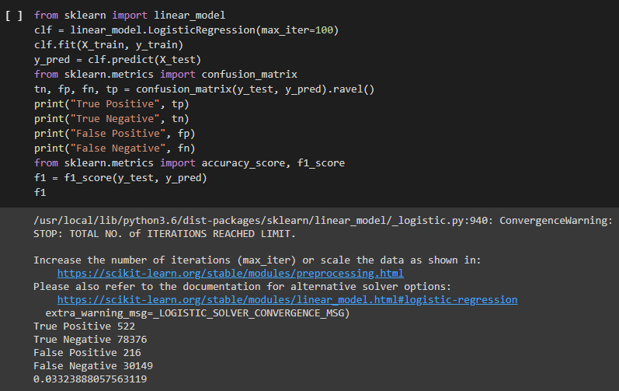
D) Define Linear Model & Import Logistic Regression

Slide 29
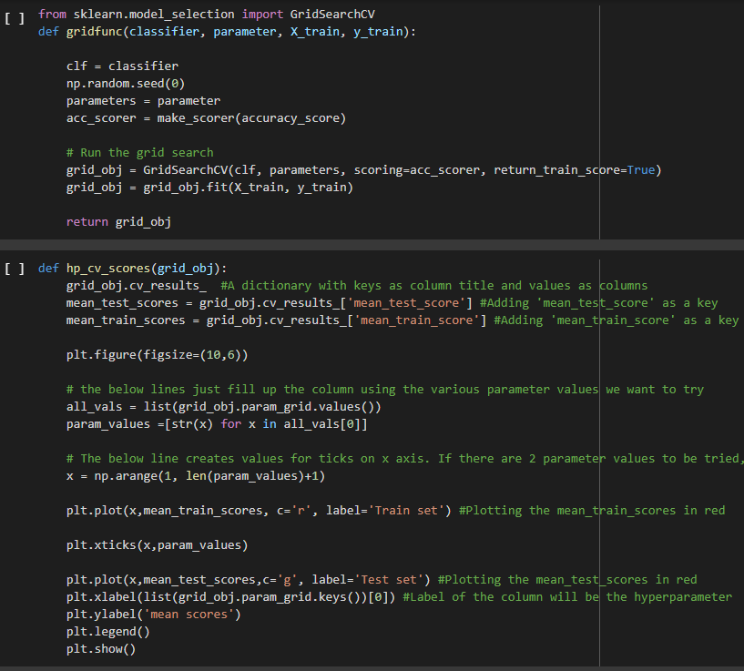
E) Using
GridSearchCV
GridSearchCV is a library function that is a member of sklearn's model_selection package. It helps to loop through predefined hyperparameters and fit your estimator (model) on your training set. In addition to that, you can specify the number of times for the cross-validation for each set of hyperparameters.

Slide 30
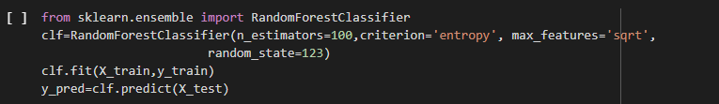
F) Using Random Forest Classifier
Random forests or random decision forests are an ensemble learning method for classification, regression and other tasks that operate by constructing a multitude of decision trees at training time and outputting the class that is the mode of the classes or mean/average prediction of the individual trees.

Slide 31
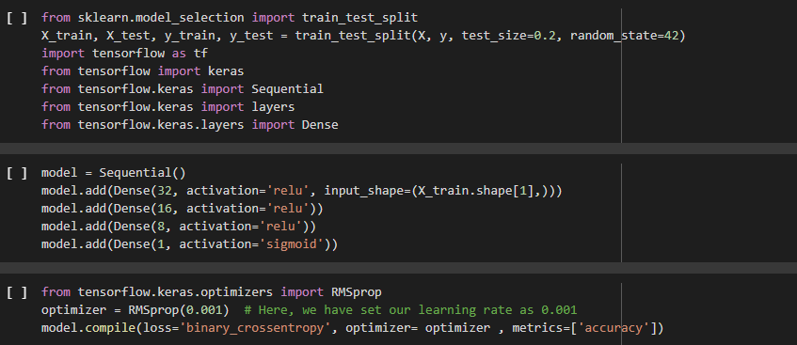
G) Prepare Sequential Deep Learning Model & Add the Dense Model Layers

Slide 32
Giving the final touches ...
Remaining Aspects : -
Research & Ideation-
Research into the the available avenues that could be worked on.
Increasing the efficiency
We're trying to increase the accuracy and efficiency of the model so we can get better prediction results.
WEEK 2
WEEK 4
WEEK 1
WEEK 3
Smoothing out the technical details
Verifying errors (if any) in code and polishing out the Snort ruleset Database.
Building an implementable solution
We're working on building an implementable version so we can effectively demonstrate the working of the product.

Slide 33

Novelty in our Idea
We're consistently trying to improve the accuracy of our model which will result in less chance of false positives thereby
improving the speed and consistency of prediction and giving users peace of mind.

Slide 34
CONCLUDING NOTE
We hope to have a significant impact in this technology niche which hasn't seen any groundbreaking innovation in the past couple of years, accelerated fault discovery and matching and protection against future attacks can bring immunity to thousands of sites and apps coming under cyber attacks everyday.

Slide 35

https://github.com/chirag-ganguli/ProjectReviewSem0x3Scr
Our Project Scratch Model Training can be found @

Slide 36

Group Members:-
Subham Biswal (19BCY10136)
Faizan Khan (19BCY10135)
Chirag Ganguli (19BCY10158)
Blesson Biju Abraham (19BCY10079)

